Slide 1


The European Research Community In The Field Of Hydrogen
Current research PRIORITIES
Rodolfo Taccani – University of Trieste
13 Nov. 2024

Slide 2











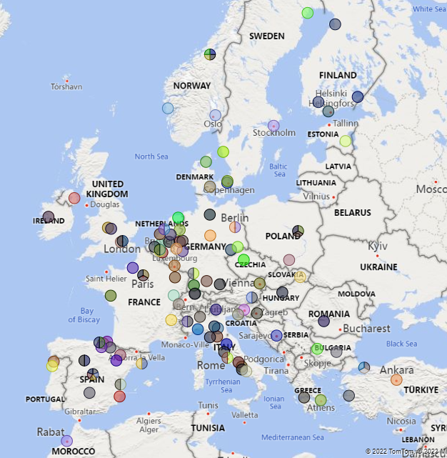










































































































































Hydrogen Europe Research at a glance
We represent the European Hydrogen Research Community with 155 members in 29 countries.
900+ scientists
involved in defining priorities
for the FCH sector

Slide 3


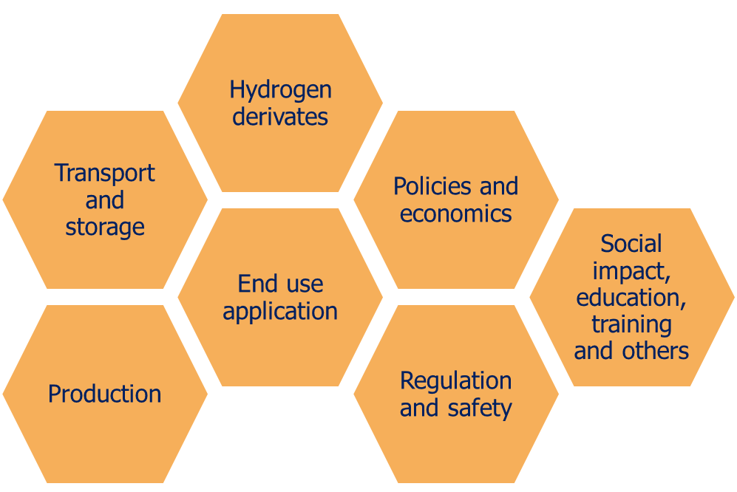
EPHyC Conference
What is EPHyC conference?
EPHyC is a conference organized by PhD students for EU-based PhD researchers working on a hydrogen-related research topic.
Topics:
More at: https://www.ephycconference.com/

Slide 4




Our vision and mission
Hydrogen Europe Research aims to contribute to the achievement of carbon neutrality by strengthening the European hydrogen industry and ensuring high-level research in Europe. We actively support Research Institutes and Universities involved in the development of a new industrial ecosystem based on hydrogen.
Supporting the excellence of European RESEARCH on hydrogen and fuel cells
Promoting the development of RESEARCH & TECHNOLOGY INFRASTRUCTURES to scale up and speed up innovation
Ensuring SUSTAINABLE DEVELOPMENT standards for a clean hydrogen ecosystem
Fostering EDUCATION and trainings to provide the European hydrogen economy with a skilled workforce
Our mission is based on 4 pillars:

Slide 5
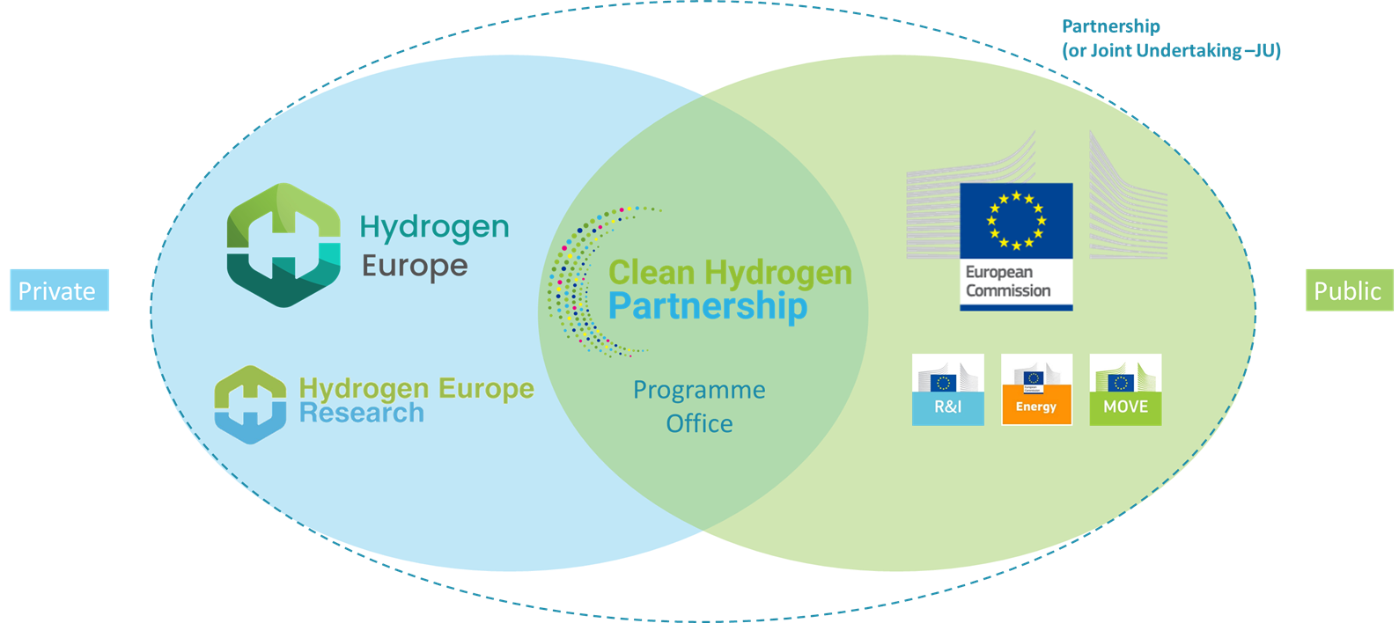
Clean Hydrogen Partnership
In collaboration with the public and private members of the Clean Hydrogen Partnership, Hydrogen Europe & Hydrogen Europe Research participate in the identification of annual and multi-annual research & innovation priorities and the elaboration of research topics included in yearly Annual Work Plans.
Budget: 1B€ + 200M€ (extra funding from REPowerEU for Hydrogen Valleys)

Slide 6
The European Union approach
Value added by RD&I
For each 1€ of EU funding received, 2.7€* were additionally funded by the private sector
*FCH II JU AAR
Creation of European Hydrogen value chains
EU technology excellence and leadership
Contribute to implementation of EU policy
Support skills development and to job creation
Value for money

Slide 7

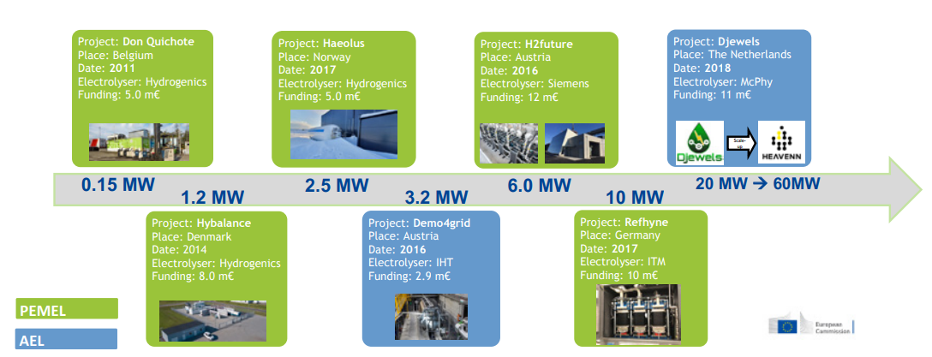
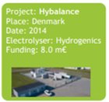

European Union approach
R&I Success stories
Electrolyser Capacity
Close to 100-fold increase (PEMEL) and 7-fold increase (AEL) in electrolyser capacities since 2007.
FCH I JU
FCH II JU
Towards 100s MW ELE by 2030
Electrolyser development and demonstration – projects from FCH I & II JU

Slide 8


European Union approach
R&I Success stories
Buses and HRS
Steady deployment of buses and Hydrogen Refueling Stations during FCH I & II JU
Some of the open R&I challenges
Multi modal
FCH I JU
FCH II JU
0
45
100
Fast delivery
Large size
0
20
113
FCs Durability
Amount of buses and HRS funded – Projects from FCH I & II JU
Notes:
Split slide into two
Add a third slide on general figures (how much money invested by industry for each euro invested by the EU, etc.)

Slide 9
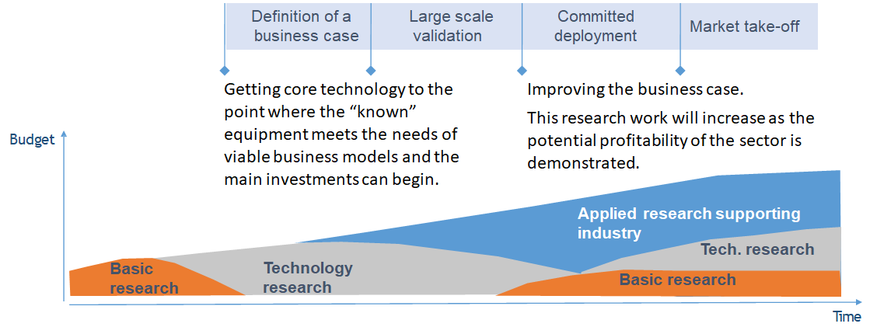
European Union approach
Circular R&D&I approach
TODAY
Early-stage technologies
First markets for hydrogen technologies
Focus on scale-up and profitability
What’s next ?
FCH 1
FCH 2
Hydrogen strategy
CHP (2020-27)
Green Deal
Fit for 55 package
RePowerEU
Industrial plan

Slide 10
European Union approach tomorrow
Why EU investment in R&I is still needed?
TO BUILD AND RETAIN EUROPEAN H2 TECHNOLOGICAL BASE ​
TO KEEP COMPETITIVE EDGE FOR YEARS TO COME
Further develop key H2 technologies ​
Breakthrough technologies
EU added value project & integrated supply chains
Complementing R&I investment gaps
Cost reduction
Increase efficiency & reliability of technology
REACHING EU LONG-TERM CLIMATE AND ENERGY OBJECTIVES
Notes:
Other priorities include: Supply chain resilience; Reduction and/or substitution of CRM and PFAS, advanced materials; Use in hard to abate sectors, Clean power and heat generation at large-scale (100MW-scale)
Main message: We need to start thinking about what should be the R&D priorities for the future. Combination of bottom up approach + guidance on priorities in line with the global context + EU policy priorities

Slide 11
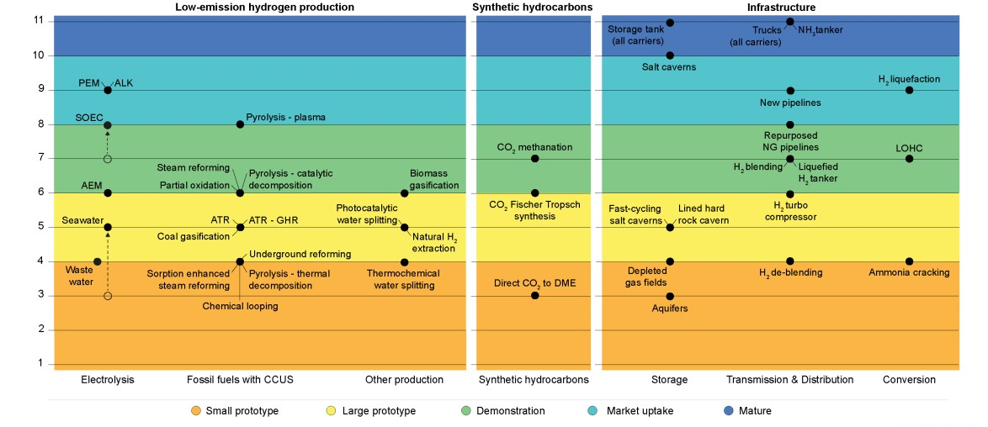
European Union approach
Why is R&I still needed? Production example
Sources: IEA Clean Tech Guide 2023; IEA Hydrogen Technology Collaboration Programme

Slide 12
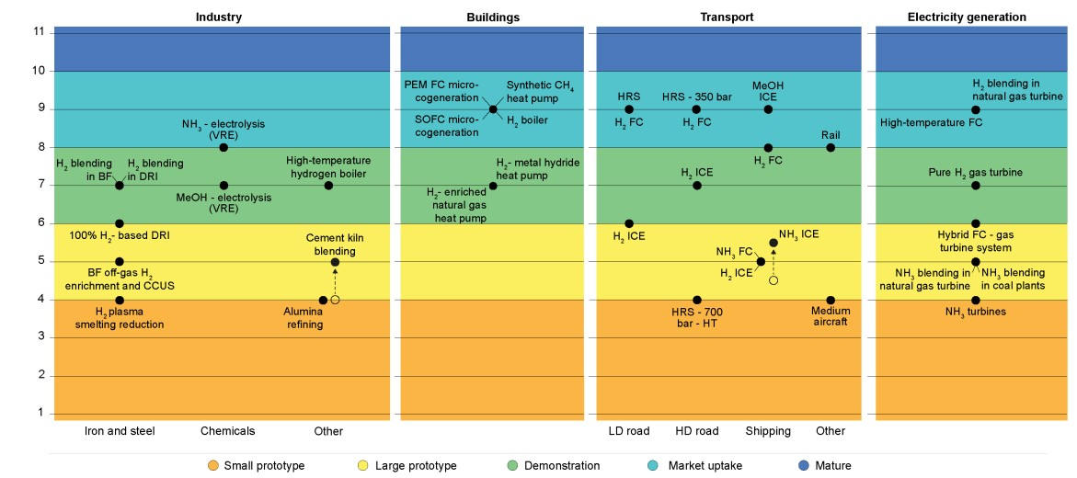
European Union approach
Why is R&I still needed? End-use example
Sources: IEA Clean Tech Guide 2023; IEA Hydrogen Technology Collaboration Programme

Slide 13

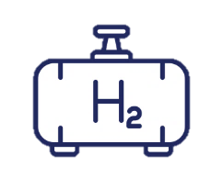









Hydrogen Value Chain efficiency and losses
Example of efficiency losses along the hydrogen value chain and key improvements
PV Performance ratio
PV Energy and power performance indexes
…
Electricity consumption
O&M cost
Lifetime
…
Tank Gravimetic density
Storage tank CAPEX
Tank capital cost
…
FC stack durability
Electricial efficiency
Quantity of H₂ consumed
…
36 Electricity production
60 Compression
/ storage
H₂
+
-
67 Hydrogen
production
H₂
- 40%
95 Electric energy
distribution
24 Fuel cell
losses
- 10%
- 30%
- 5%
Other end uses
Electricity production from RES sources
7 Storage
losses
29 Electrolyser
losses
5 Transmission
losses
13

Slide 14
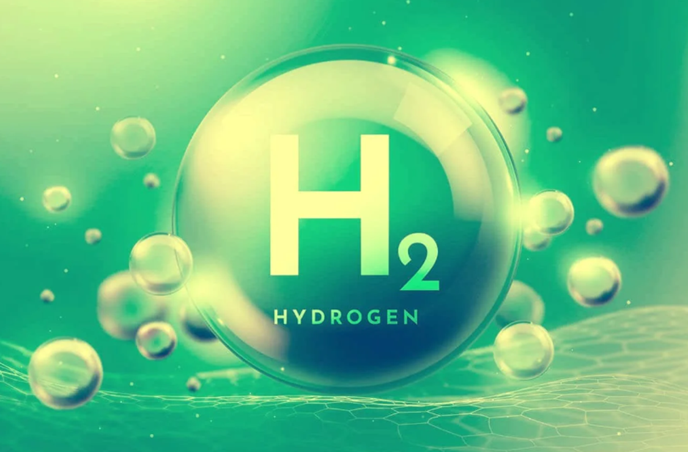


Digital models for H₂ distribution
Thank you !
Rodolfo Taccani
taccani@units.it

Slide 15
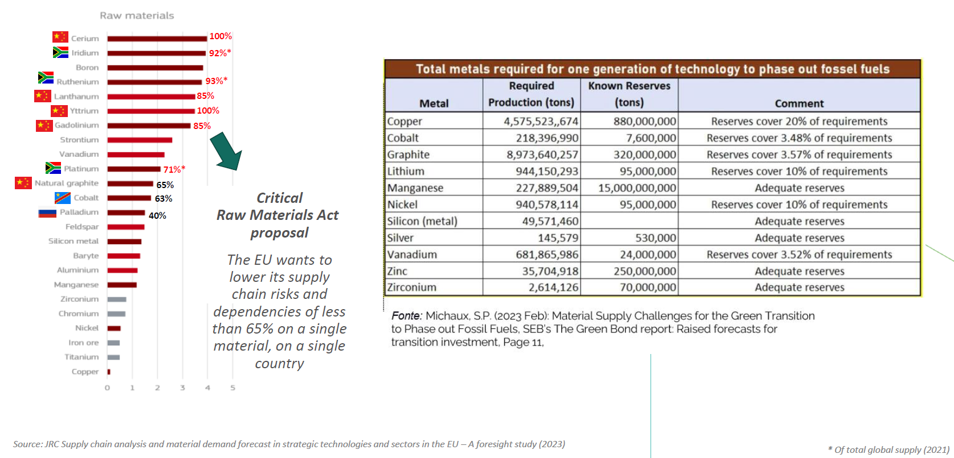
Dependency on raw materials (extraction and processing)
for electrolyser and fuel cells
Platinum Group Metals (Ir, Pd, Pt, …)
Iridium (Ir, IrOx) used for oxygen evolution reaction (OER) catalyst at the anode of the PEM electrolyser – best tradeoff between activity and stability
Palladium used in both fuel cells and electrolysers. 47% mining capacity in Russia
Rare earths:
Scandium (3/4 of the global Scandium market in 2017 was on SOFC to be used as an electrolyte), supplied by China and Russia. Then Yttrium
Source: JRC Supply chain analysis and material demand forecast in strategic technologies and sectors in the EU –A foresight study (2023)

