Slide 1
Joint sizing-operation optimization for investment de-risking
Prof. Mario Vašak, University of Zagreb Faculty of Electrical Engneering and Computing
Laboratory for Renewable Energy Systems
14 November 2024, Nova Gorica

Slide 2
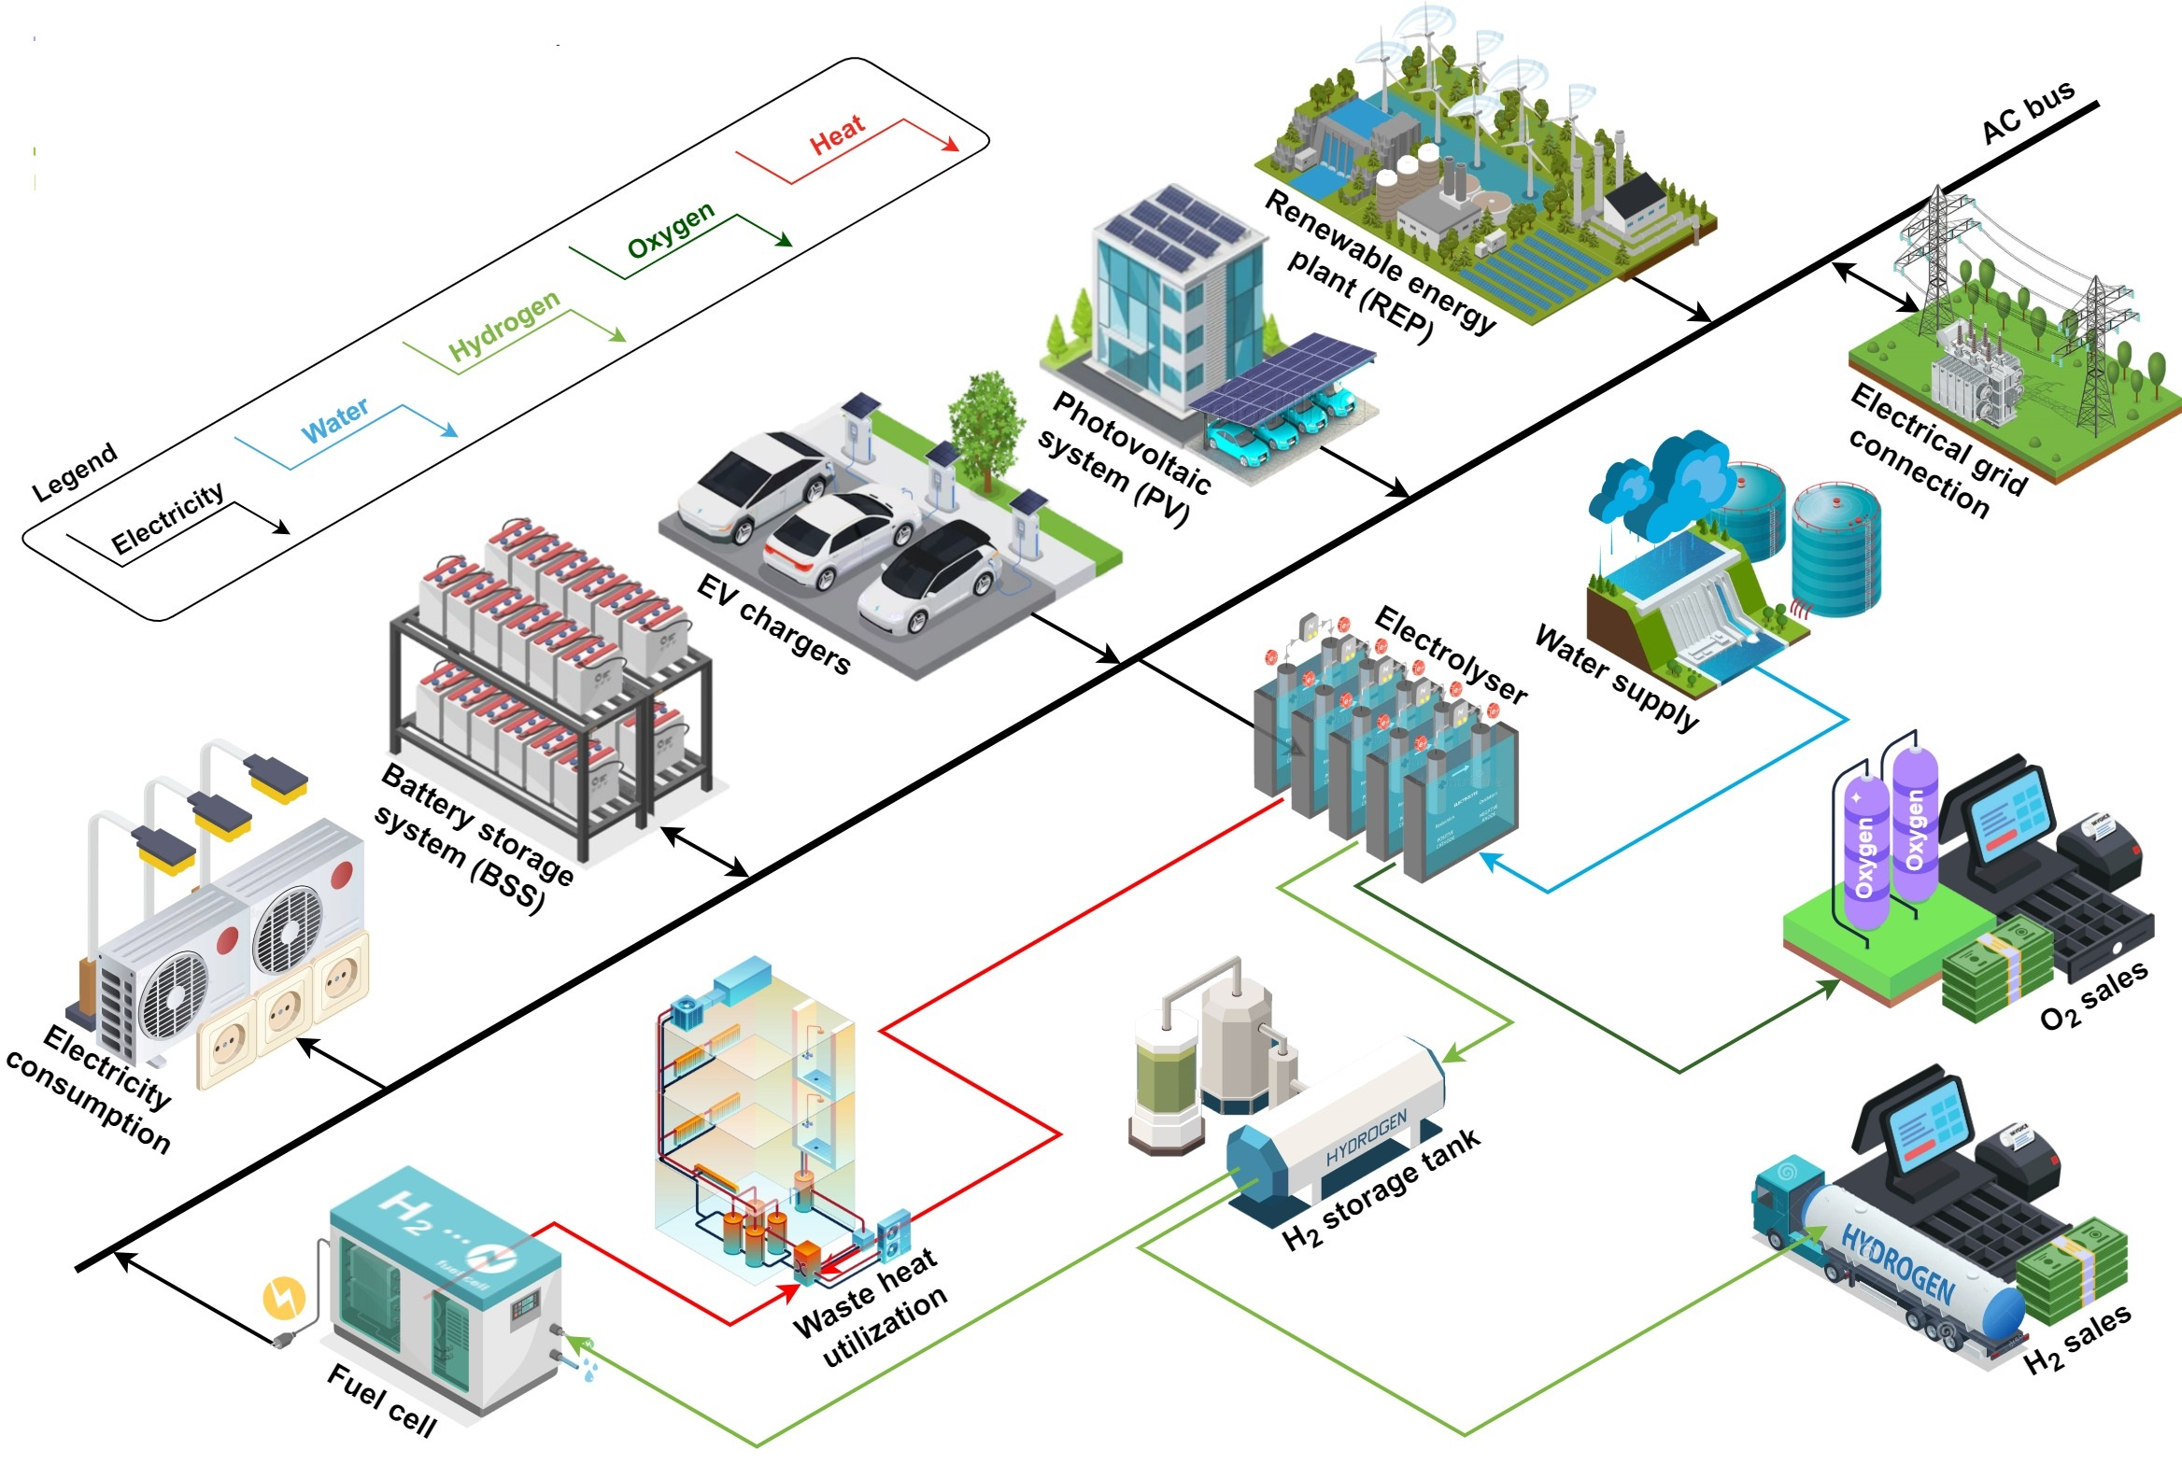
Investment in an energy hub
What set of technologies to use?
What should be the sizes of its components?
How should it be operated?
... in very dynamic market, technical and environmental conditions

Slide 3
Investment in an energy hub
Strongly interdependent decisions!
The only right thing:
Optimize all at once!

Slide 4
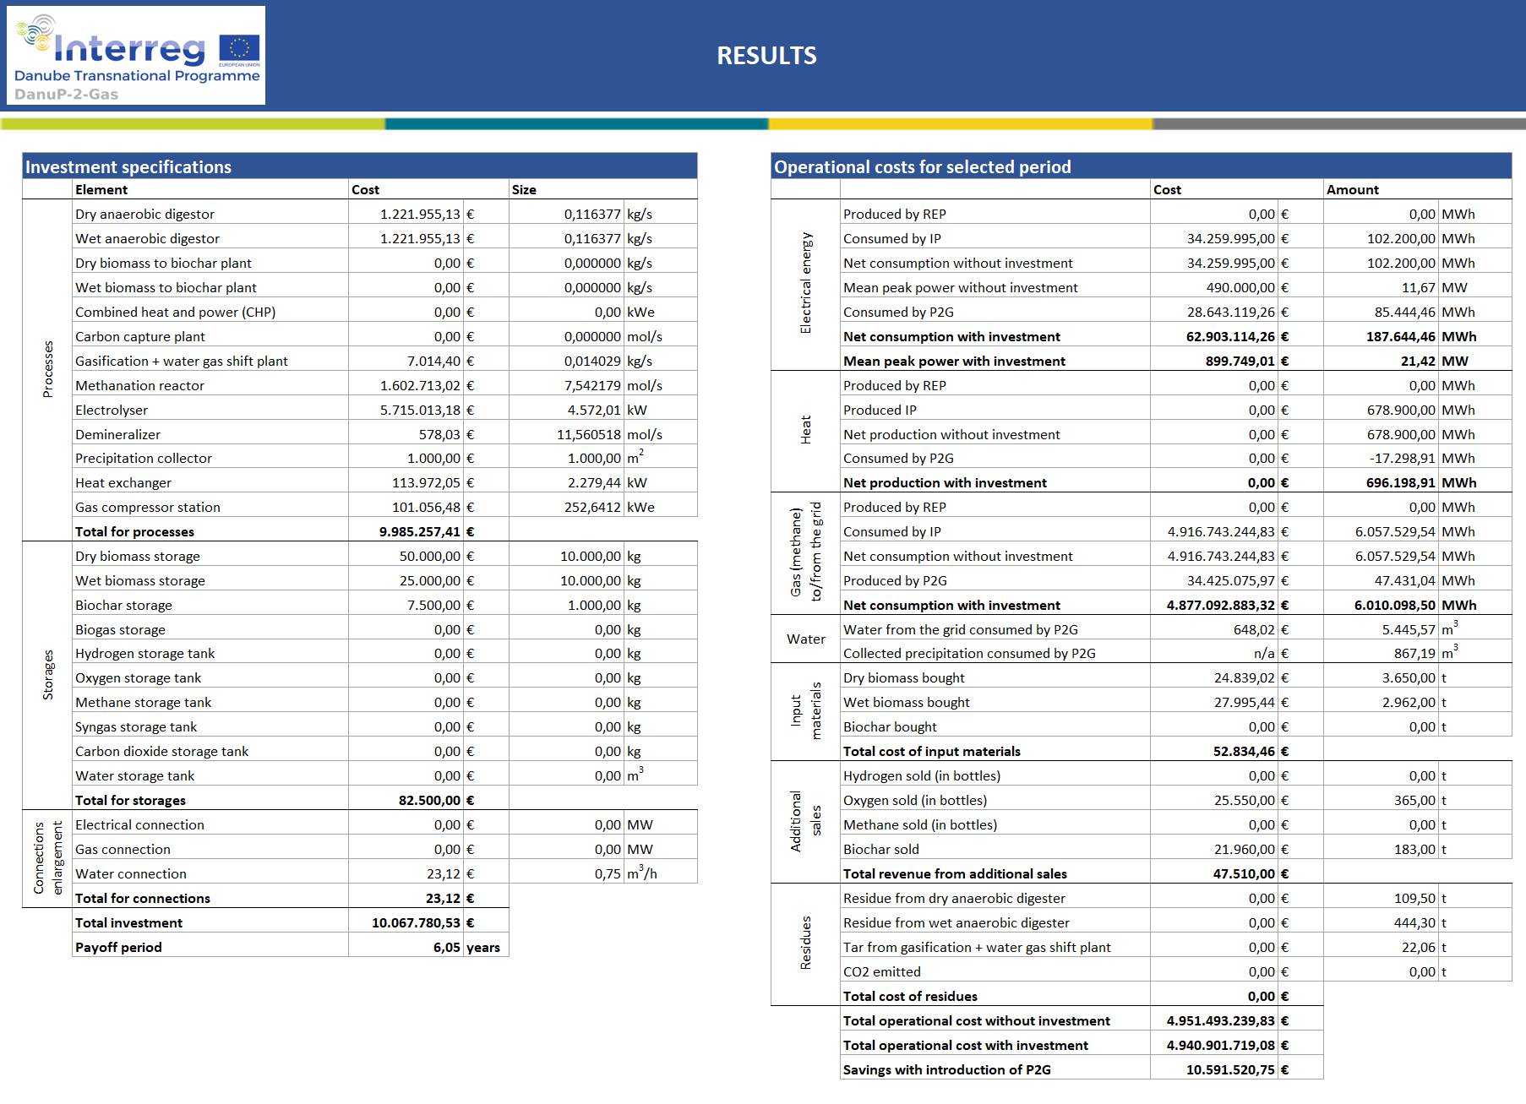
Joint sizing-operation optimization tool for energy hubs
The first version fully developed for a broad set of power-to-gas technologies
Available for download, with manuals and video https://danup2gas.eu/optimizationtool
Excel-based tool:
Set technology parameters
Define market conditions
Embed with existing consumer/renewable energy plant
Press optimize & get:
optimal sizes,
year-round operation schedule, and
techno-economical analysis

Slide 5
Potential?
Immense:
Including other new technologies in the tool
What-if scenarios analyses
Easy transfer into day-to-day energy hub operation
Business offer:
Knowledge transfer on how to use the tool
Tool usage for the customer for a specific site in a plethora of scenarios
Tool further adaptation according to the customer needs

Slide 6
Follow-up in NACHIP (+ Danube Indeet + HyEfRE)
Adapt the set-up of technologies considered
Danube Indeet: Electrolyser, EV chargers, Fuel cells, PV, Batteries
HyEfRE: Collection of different electrolysers technologies at once
NACHIP: Technologies developed/tested in pilots to support their further replication
Graphical user interface which further facilitates the tool usage

Slide 7
https://www.lares.fer.hr

