Slide 1
DANIELI GREEN METAL
GIANFRANCO MARCONI
EVP R&D
14.11.2024

Slide 2
Danieli
The Company
Danieli ranks among the three major plantmakers supplying the steel and nonferrous metal industries worldwide
Ore treating, iron and steelmaking plants, casters, rolling mills, forging, extrusion and finishing lines for flat, long and tubular products

Slide 3
Danieli
Financial position
4 000
Danieli Group: Sales Revenue
3 500
3 000
2 500
2 000
1 500
1 000
500
3 115
3 210
2 583
3 118
3 081
2 782
2 944
2 766
2 508
2 491
2 706
3 064
2 673
2 725
3 637
4 102
4 349
(millions of euro)
2008
2009
2010
2011
2012
2013
2014
2015
2016
2017
2018
2019
2020
2021
2022
2023
2024

Slide 4
Danieli Plantmaking
Worldwide presence
Service centers
Local branches

Slide 5
Danieli
Research and development
250
Research (lower columns)
and costs incurred
for new products development
230
225
200
200
200
200
200
200
175
150
125
100
75
50
160
170
165
200
170
170
25
0
30
35
30
30
30
40
(millions of euro)
18/19
19/20
20/21
21/22
22/23
23/24

Slide 6
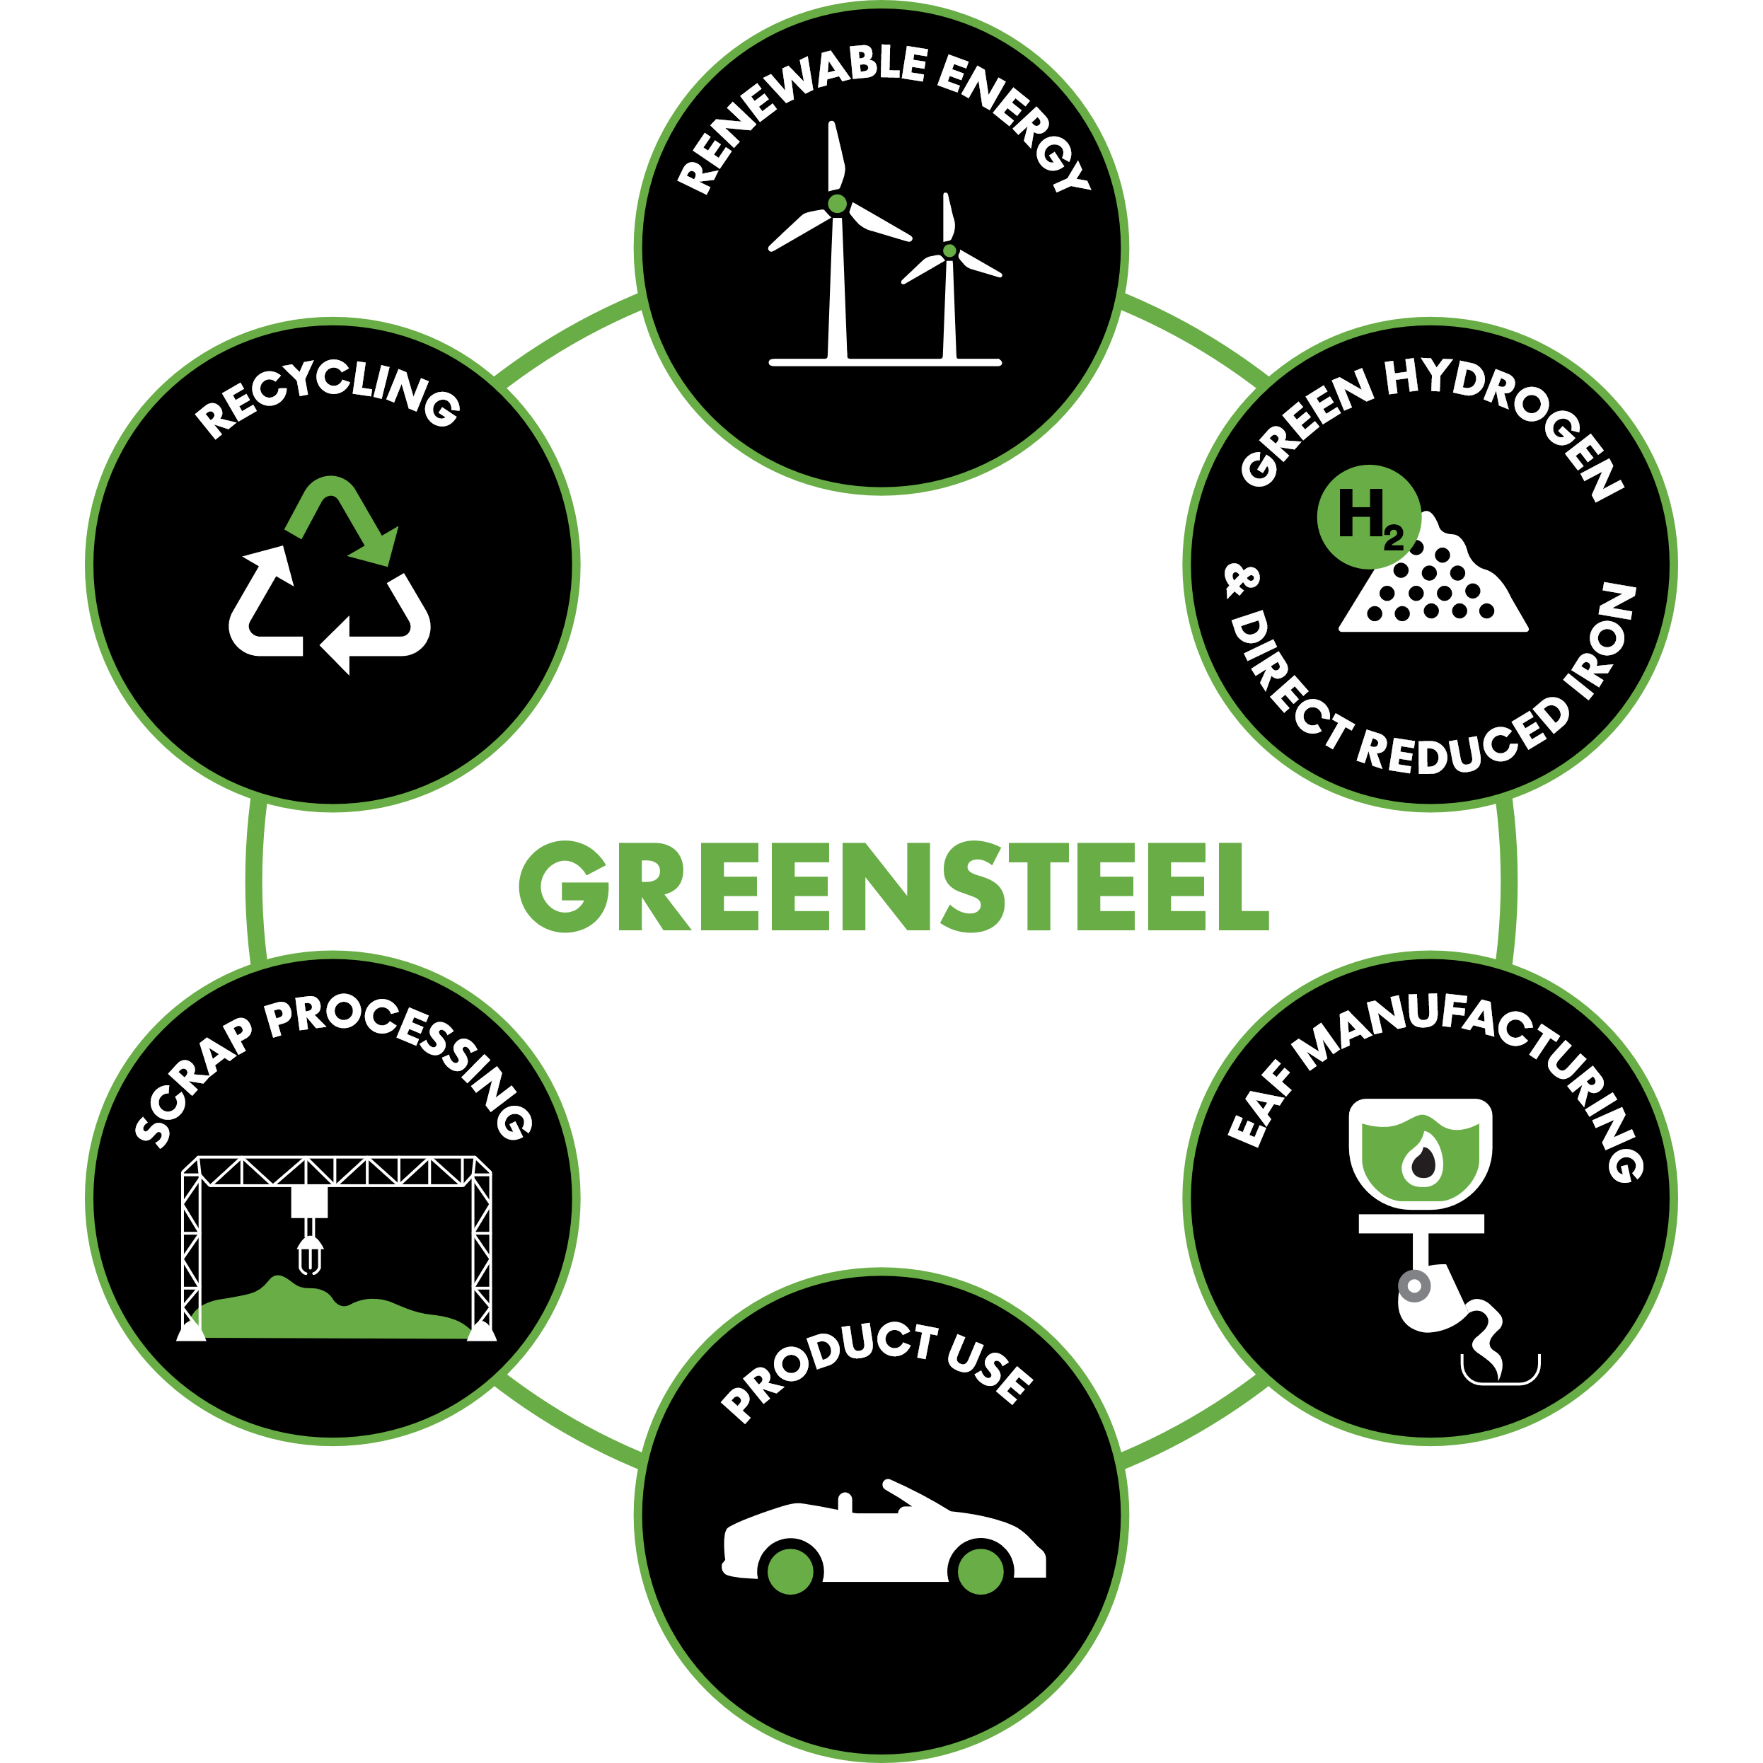
Introduction
Re-cycling of CO₂ (CCS – CCU)
Switch of energy source
Reach ZERO carbon emissions in steel making is possible?

Slide 7
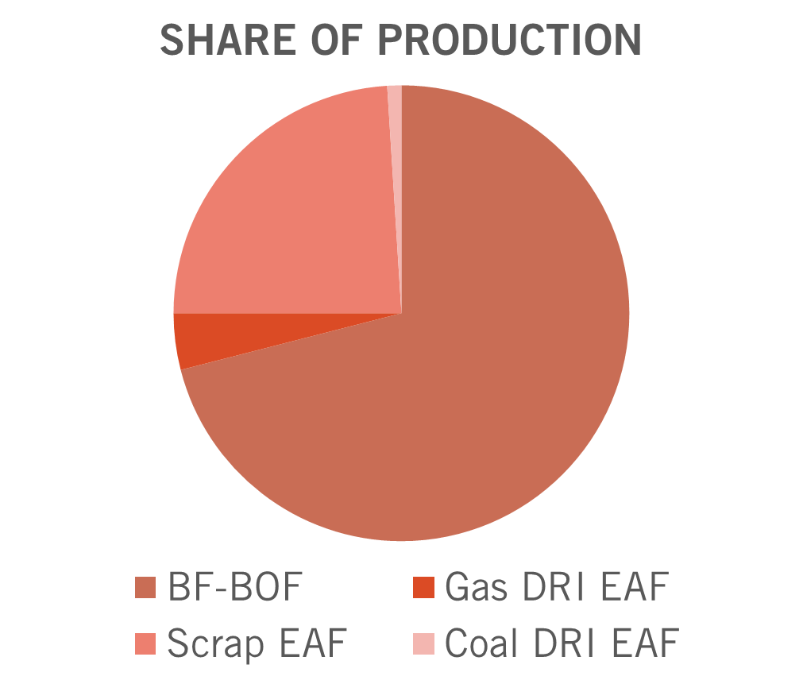
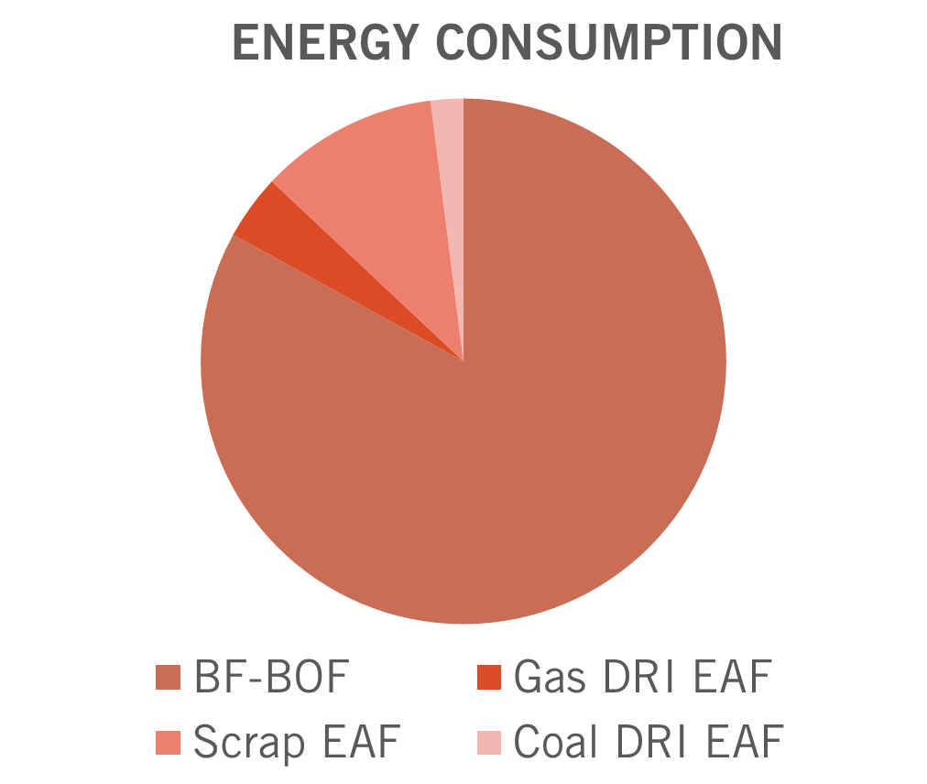
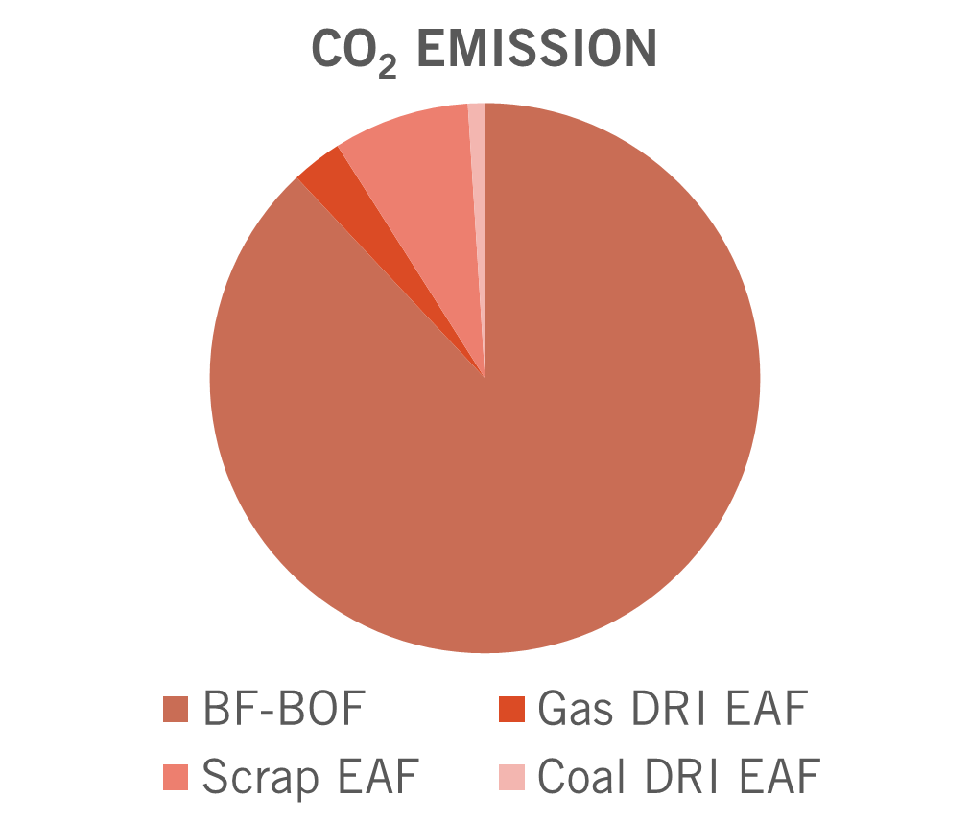
Current production relies on blast furnace route

Slide 8
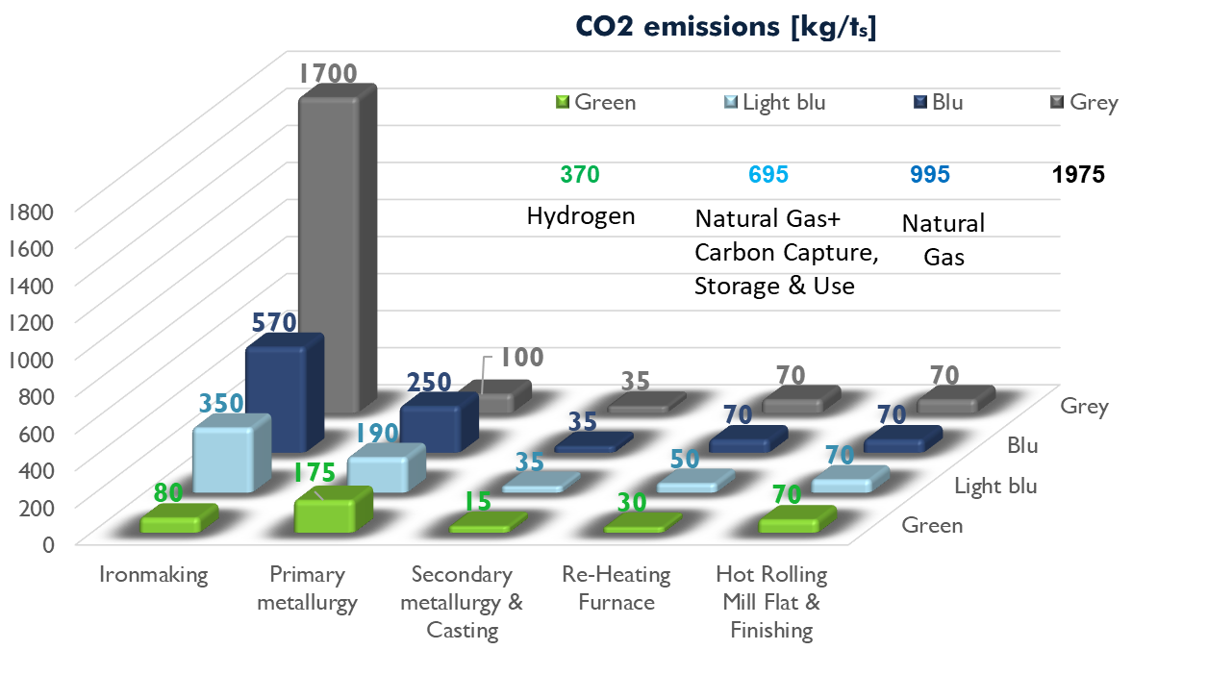
COMPARISON OF EMISSIONS SCOPE 1&2 FOR STEEL PRODUCTION ROUTES
Blast Furnace + BOF
COAL
NATURAL GAS
HYDROGEN

Slide 9
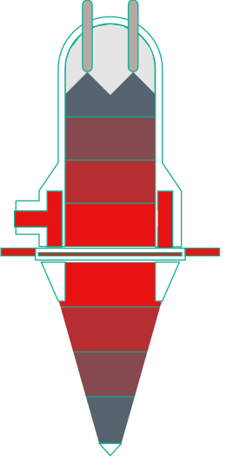
Energiron process – process flow diagram
WATER REMOVAL
TOP GAS HEAT RECUPERATOR
IRON ORE
Process gas COMPRESSORS
PG HEATER
ENERGIRON
REACTOR
CO2
REMOVAL
O₂
NG
H2
HUMIDIFIER
EPGH MODULE

Slide 10
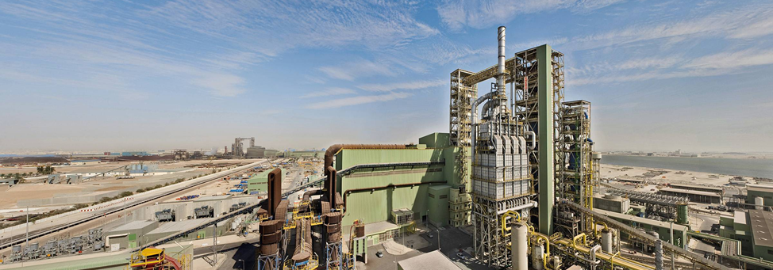
Direct reduction plant (DRP)

Slide 11
Transition towards Net-zero co2 emission in dri production
CO₂ CAPTURE AND UTILIZATION
HIGH PERCENTAGES OF HYDROGEN
E-PGH MODULES
FLEXIBLE PATH TO LOW CARBON FOOTPRINT

Slide 12
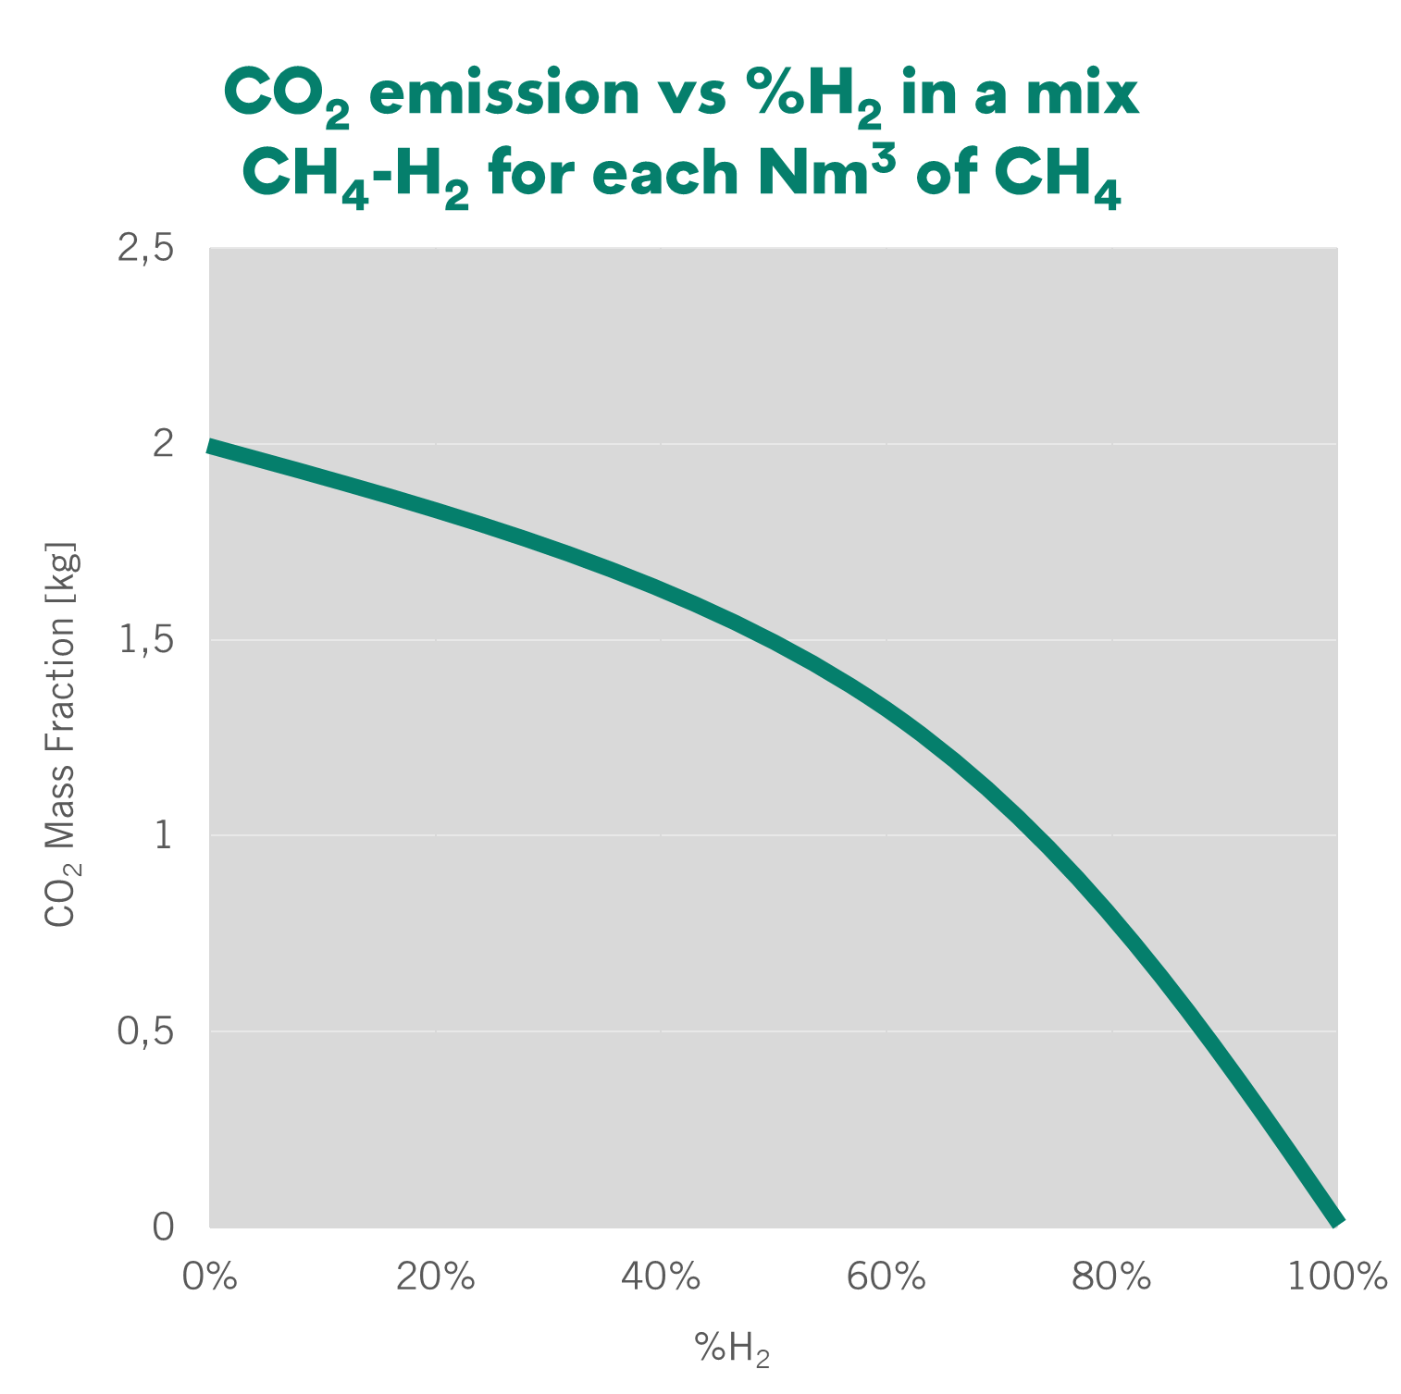
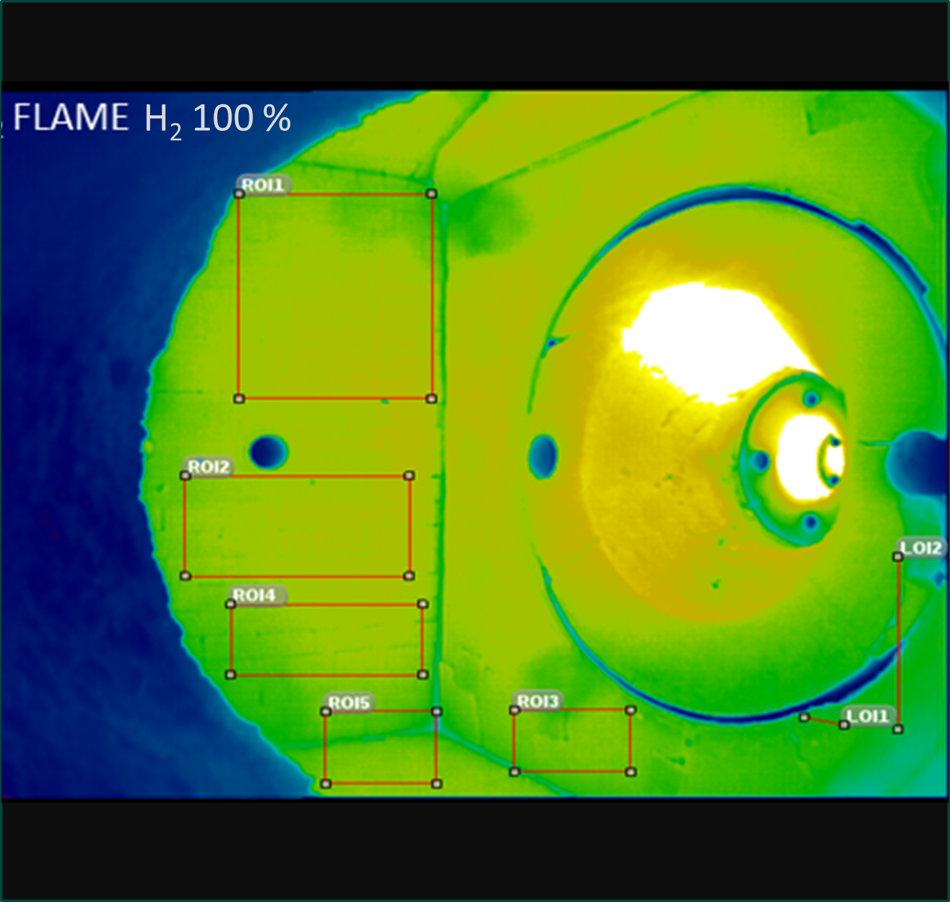
HYDROGEN BURNER

Slide 13
HYDROGEN BURNER
Pros:
CO₂ Reducing
Solution:
Flameless Technology
Cons:
NOx Emission
High thermal stress on burner

Slide 14
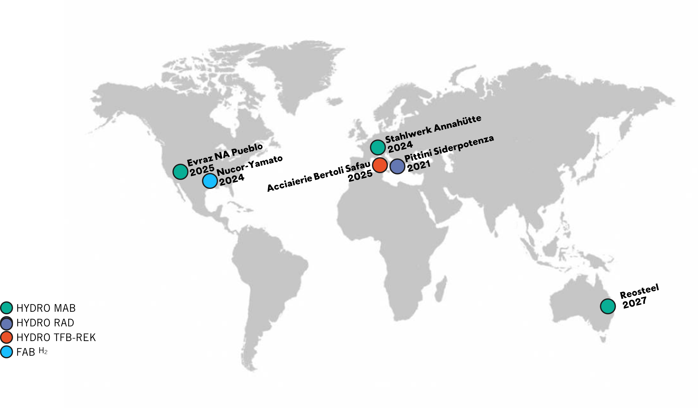
H2 Burners Installed– Reference List

Slide 15
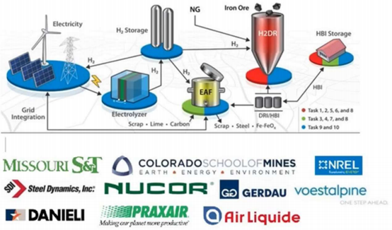
GISH - GRID INTERACTIVE STEELMAKING WITH H2
Project financed by DOE (Department Of Energy), started in 2021
Integrating renewable sources power grid with H2 DRP and EAF production
Use the excess energy from renewables to convert it in hydrogen and use it to produce clean steel

Slide 16
NAHV - ABS H2 utilization for special steel
production and treatment testbed application
Heat treatment furnace to anneal continuous casting blooms or ingots or bars
Upgrading of the combustion system
18 burners to operate with hydrogen and natural gas mixtures in the range 0-100%
Hydrogen supplied by truck from the production site (external supplier part of NAHV Consortium) to ABS
Hydrogen stored in tanks of such capacity as to ensure the operations of entire heat treatment cycle in case of 100% H2 blend.

Slide 17
Thank you for the attention

