Slide 1
Zero Emission Adriatic Ship – ZEAS
Date: 14.11.2024.

Slide 2
Project overview
Programme: Horizon Europe, Cluster 5: Climate, Energy and Mobility
Project duration: 01.01.2024 - 31.12.2027,
Project budget: ~18,9 Mio. EUR
Funded budget: ~13,5 Mio. EUR
Project coordinator: Lürssen Design Center Kvarner
Project partners: Norway, Greece, Spain, Germany, Austria, Slovenia, Croatia

Slide 3
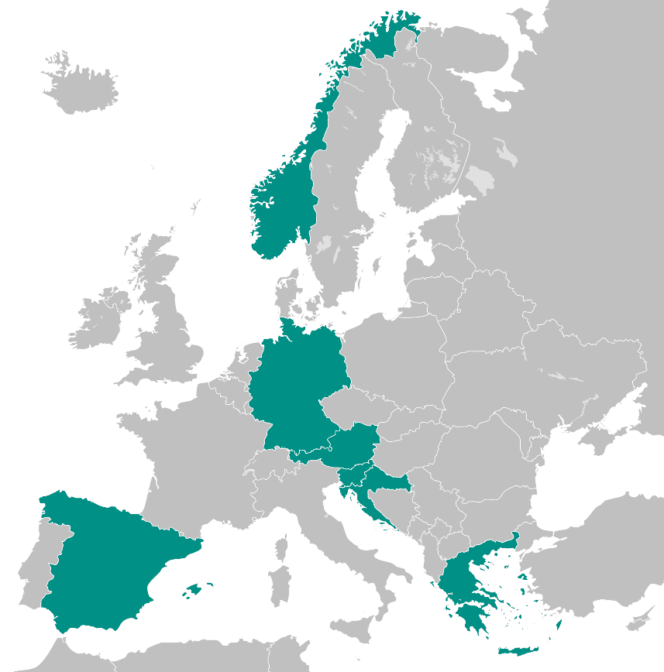
Project partners

Slide 4
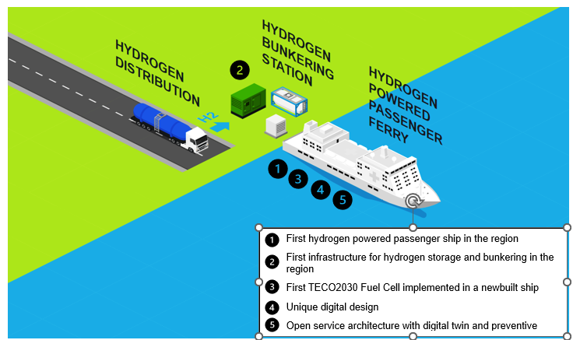
ZEAS project

Slide 5
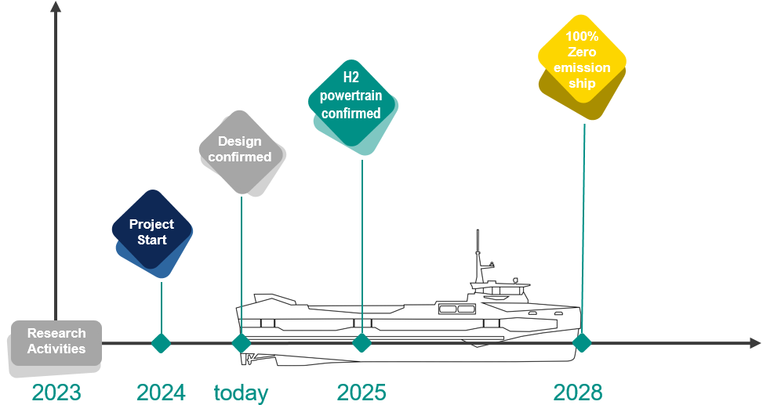
ZEAS results and time plan
Hydrogen-fuelled vessel (TRL 9)
Hydrogen infrastructure system (TRL 9)
Digital technologies (efficiency & safety of operations) (TRL 9)
Good environmental practice manual
Safety standard recommendations
Feasibility and business plan

Slide 6
Work package structure
WP1 – Project management and Coordination
WP2 – Hydrogen-powered ship design and construction
WP3 – H2 distribution, storage and bunkering
WP4 – Digital technologies
WP5 – Safety and the Environment
WP6 – Dissemination, communication and exploitation

Slide 7
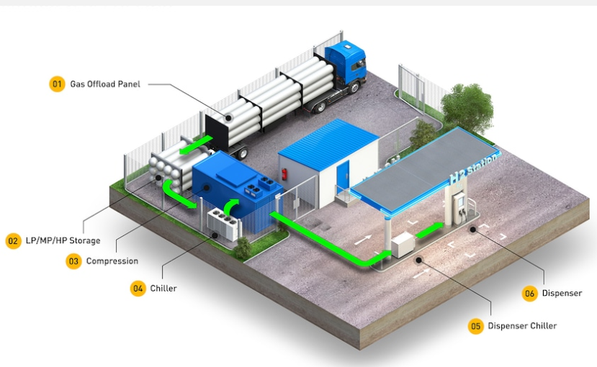
Hydrogen Refuelling Station
Mobile solution
Supply ship solution
Swap solution
Permanent solution
Hybrid solution

Slide 8
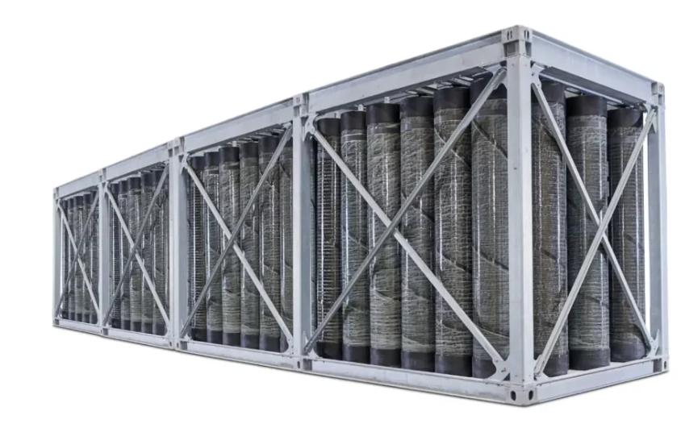
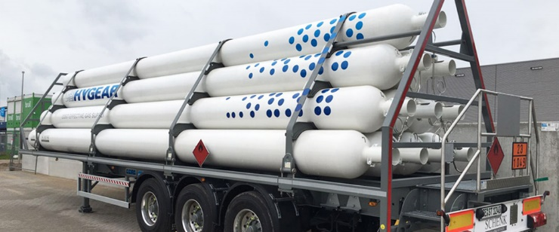
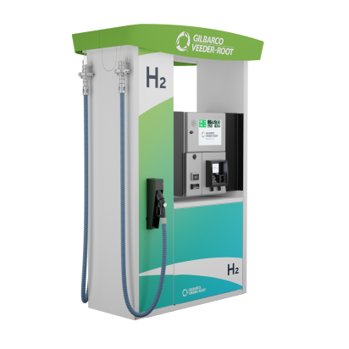
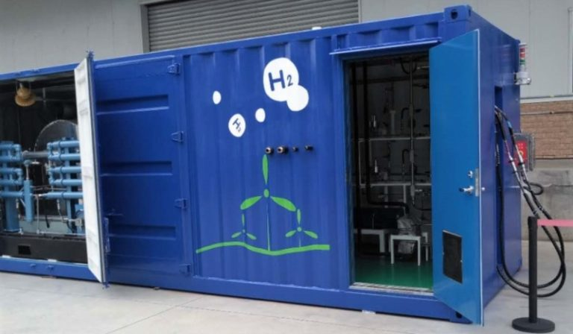
Hydrogen Refuelling Station Components
Onshore hydrogen storage
Tube trailers
Dispenser
Compressor station

