Slide 1
Panel 1 Industry Goes Hydrogen Hydrogen in Industry: Opportunities for Slovenia's Economy
Brigita Habjan Štolfa
Notes:
Good morning everyone,
My name iz Brigita Habjan Štolfa, Thank you for invitation.
It’s a privilege to speak on behalf of the Northern Primorska Chamber of Commerce and Industry about the role of hydrogen in transforming our industries and driving economic growth in Slovenia.

Slide 2
Introduction to Hydrogen in Slovenia’s Industry
Importance of hydrogen in reducing carbon emissions.
Slovenia’s goals for green energy and how hydrogen fits within these goals.
Notes:
The Slovenian Chamber of Commerce and Industry (SCCI) recognises hydrogen technologies as one of the key potential technologies
for achieving climate neutrality and transforming industry in line with the requirements of the green transition.
Today, I’ll outline how Slovenia can embrace hydrogen as a powerful force for sustainable industry and economic resilience.
I’ll focus on three areas:
production and infrastructure,
industrial applications,
and regional positioning as part of the North Adriatic Hydrogen Valley.

Slide 3
Green Hydrogen Production Potential
Slovenia’s potential for green hydrogen using renewable resources like solar, wind, and hydro power.
Benefits of green hydrogen for sustainability and job creation.
Notes:
First, let’s consider Slovenia’s potential for producing green hydrogen.
As we transition away from fossil fuels, the ability to produce hydrogen from renewable sources, such as hydro, solar, and wind,
offers Slovenia an opportunity to become a regional leader.
Green hydrogen can help Slovenia meet its climate goals and create a new industry with high-quality jobs.
Our access to renewable resources and Slovenia’s technical and engineering expertise are major assets here.
With the right incentives, Slovenia can establish itself as a central player in the European hydrogen supply chain.
Investments in electrolysis technology and renewable energy sources could allow Slovenia not only to produce enough green hydrogen for domestic needs but also to export it to neighboring countries.

Slide 4
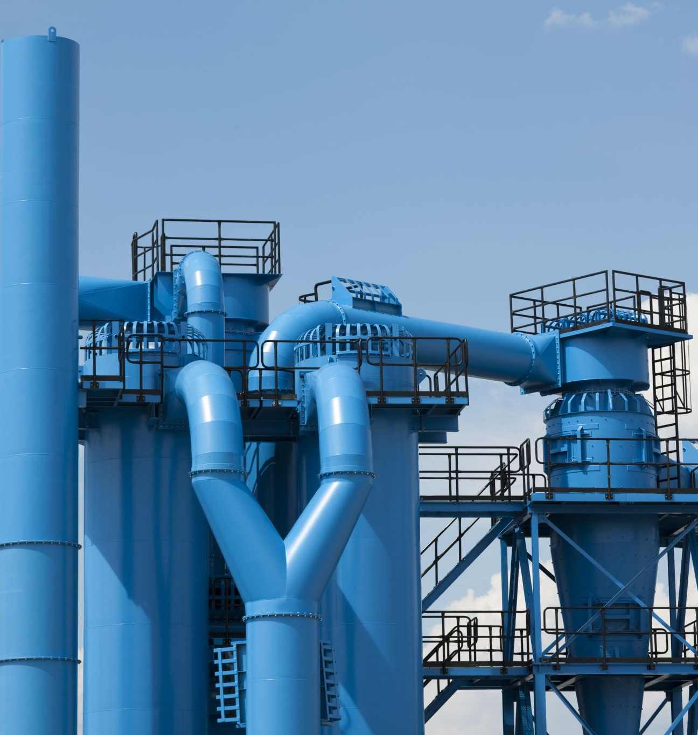
Infrastructure Development for Hydrogen
Importance of establishing hydrogen refueling stations and pipelines.
Slovenia’s strategic position as a transit hub for hydrogen in Europe.
Notes:
Next, we need to address infrastructure.
Establishing hydrogen refueling stations and pipelines within Slovenia and across the North Adriatic region is essential.
This infrastructure would enable broader hydrogen adoption in both public and commercial transport.
Slovenia’s central location at the heart of Europe makes it an ideal hub for hydrogen transit, connecting Central Europe with the Mediterranean.
Through regional cooperation with Italy and Croatia, we can create an interconnected hydrogen infrastructure that aligns with the EU’s vision for a Hydrogen Backbone network.
As part of the North Adriatic Hydrogen Valley initiative, Slovenia has the chance to lead in hydrogen distribution and logistics, creating a new economic ecosystem that supports local industries and attracts international partners.

Slide 5
Industrial Applications of Hydrogen
Hydrogen’s potential to decarbonize industries like steel, cement, and chemicals.
Helping Slovenian industries meet EU carbon-neutral standards.
Notes:
Hydrogen is particularly promising for Slovenia’s industrial sector, especially in energy-intensive industries like steel, cement, and chemicals, where it can be used to replace fossil fuels.
By switching to hydrogen, these industries can significantly reduce emissions and become more competitive in global markets that are increasingly demanding low-carbon products.
For instance, the steel industry can utilize hydrogen in steel production, which would not only reduce emissions but also enhance Slovenia’s competitiveness in the EU’s carbon-neutral marketplace.
Early adopters in Slovenia will likely enjoy a competitive edge, particularly as the EU moves towards more stringent carbon regulations and a green economy.

Slide 6
Hydrogen-Powered Mobility
Role of hydrogen in public and commercial transportation for long-range and heavy-duty vehicles.
Potential for hydrogen-powered buses, trucks, and possibly trains.
Notes:
Hydrogen can also transform transportation in Slovenia.
While electric vehicles are part of the solution, hydrogen fuel cells offer greater range and shorter refueling times, especially for heavy-duty and long-haul vehicles.
Hydrogen-powered buses, trucks, and trains are particularly promising for Slovenia’s mountainous regions and longer routes.
Establishing a network of hydrogen refueling stations along key routes would make hydrogen-powered transport viable, reducing emissions in public and commercial transport sectors and aligning with EU sustainability targets.
By investing in this infrastructure, Slovenia can also attract companies involved in hydrogen mobility, building a new sector within our economy.

Slide 7
Energy Storage and Grid Stability
Hydrogen’s role in storing renewable energy and ensuring grid stability.
Producing hydrogen when demand is low and using it when demand is high.
Notes:
Hydrogen also offers an efficient way to store renewable energy, which is crucial for grid stability.
By converting surplus renewable energy into hydrogen, Slovenia can build a more resilient energy grid.
Stored hydrogen can be used during peak demand times, reducing reliance on imported energy and enhancing energy independence.
Hydrogen’s role as an energy storage solution can provide stability to our grid, helping Slovenia manage renewable energy more effectively and achieve its goal of energy self-sufficiency.

Slide 8
Regional Cooperation – North Adriatic Hydrogen Valley
Slovenia’s involvement in the North Adriatic Hydrogen Valley with Italy and Croatia.
Benefits of regional cooperation in building a hydrogen economy.
Notes:
Slovenia – Northerm Primroska region is part of the North Adriatic Hydrogen Valley (NAHV),
a transnational initiative that fosters collaboration between Slovenia, Italy, and Croatia.
This partnership provides an excellent opportunity for Slovenia to learn from and collaborate with our neighbors, pooling resources to drive innovation in hydrogen technology and infrastructure.
The Hydrogen Valley initiative supports knowledge exchange, collaborative projects, and shared investment, creating a robust ecosystem that spans national borders.
By aligning our policies and investments, we can make the North Adriatic region a European leader in hydrogen.

Slide 9
Fostering Innovation and Investment
Importance of R&D and government support for hydrogen projects.
Potential for attracting investors and creating a hydrogen economy.
Notes:
To fully embrace hydrogen, we need investment in research, technology, and infrastructure.
Slovenia’s strong educational institutions and skilled workforce are assets that can attract international partnerships.
We can leverage our engineering talent and research facilities to foster hydrogen innovation, from production and storage solutions to specialized industrial applications.
At the same time, government incentives and policies that support green hydrogen production, such as subsidies, tax benefits, and R&D funding, can create a favorable environment for investors.
By acting now, we can establish Slovenia as a regional hub for hydrogen technology development.

Slide 10
Conclusion
Summary of key points: green hydrogen production, infrastructure, industrial applications, and North Adriatic Hydrogen Valley.
Slovenia’s opportunity to lead in hydrogen and contribute to Europe’s green transition.
Notes:
In closing, hydrogen represents a unique opportunity for Slovenia to lead in Europe’s green transition.
By focusing on green hydrogen production, investing in infrastructure, and supporting industrial and transportation applications,
Slovenia can harness hydrogen’s potential to build a more sustainable, resilient, and competitive economy.
Through initiatives like the North Adriatic Hydrogen Valley, we can collaborate across borders and create an integrated hydrogen ecosystem that positions Slovenia at the forefront of Europe’s hydrogen future.
Thank you, and I look forward to exploring these opportunities together.

